Slide 1
Sathyaish Chakravarthy
An Introduction to Rx

Slide 2
What is Rx? What problem does it solve?
Write some code to show me how it solves the problem.
How does it work?

Slide 3
Prerequisites
How to write an event handler in .NET
What is a delegate and how to use one?
What is the IEnumerable<T> interface used for?
IEnumerator<T>?
How to write IEnumerable<T> and IEnumerator<T> imeplementations?
Standard LINQ query operators
LINQ query expression syntax
Writing LINQ queries over IEnumerable<T>
Working with lambda expressions

Slide 4
Definition
The Reactive Extensions (Rx) is a library for composing asynchronous and event-based programs using observable sequences and LINQ-style query operators. Using Rx, developers represent asynchronous data streams with Observables, query asynchronous data streams using LINQ operators, and parameterize the concurrency in the asynchronous data streams using Schedulers. Simply put, Rx = Observables + LINQ + Schedulers.

Slide 5
Pull based data model
Data source
Your program
Interactive Programming

Slide 6
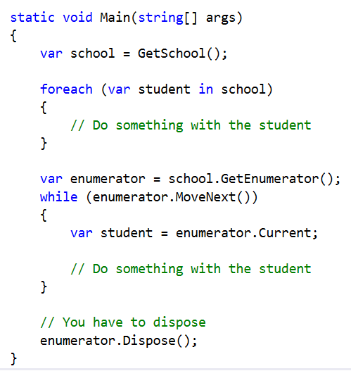
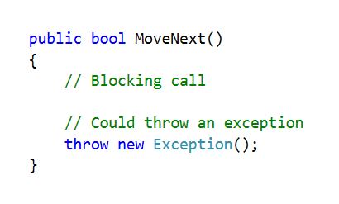
Pull based data model
(Interactive Programming Model)
Data Reader

Slide 7
Push based data model
Data source
Your program
Reactive Programming

Slide 8
Rx enables your program to react to data instead of to have to ask for it.

Slide 9


Wait! Aren’t we mixing up two very different things?
Sequences
Events

Slide 10
Pull based data model
Data source
This could be anything. Not necessarily traversing a sequence. It could be a single operation returning a single value, like a Web service call
Your program
Interactive Programming

Slide 11
Pull based data model
(Interactive Programming Model)
Sequence
Data Reader

Slide 12
Push based data model
Data source
Event
Your program
Reactive Programming

Slide 13
Sequence<T>
(IEnumerable<T>)
Web Service Call
Foo FooService.GetMeOneFooPlease();
IEnumerable<Foo> FooService.GetMeOneFooPlease();

Slide 14
RxDataStructure<T>
Web Service Call
RxDataStructure<Foo> FooService.GetMeOneFooPlease();
// I am going to start doing other things. Please give me one foo
// when it arrives. Don’t bother me until then, please!
var rxOfFoo = FooService.GetMeOneFooPlease();
await rxOfFoo;
var rxOfBars = KeepPoppingBarsMyWayAsAndWhenTheyAppearPlease();

Slide 15
Brother from another mother
IEnumerable<T>
IObservable<T>
Both represent sequences in different universes.
One will go get each value one at a time and block until each value is received.
The other will keep having values popped into it as and when they occur and will let you know every time.
Both can be queried using LINQ style operators.

Slide 16
Mathematical Duality
// Func<int, double>
// Inverse of function
x => x / 2;
x => 2 * x;
// Dual of function
// Func<double, int>
// Func<int, double>
double GetPrice(int itemId);
int SetPrice(double price);

Slide 17

So this, RxDataStructure<T> has some kind of internal storage, right?
Just like IEnumerable<T>, correct?
Because it is a sequence, right?
Like, it has to store all the values somewhere?

Slide 18
No!

Slide 19
Rx introduces the notion of time!

Slide 20
We are used to thinking of a sequence as this, so far
Finite
Something finite; well, you can have infinite sequences, but…
Storage
But we have psychologically come to associate them with a backing store

Slide 21
A sequence may be the occurrence of a single event over a period of time.

Slide 22
Rx challenges our notion of a sequence thus
Event
“The occurrence of this single event over time is a sequence.”

Slide 23
Rx challenges our notion of a sequence thus
“An event is a source of data.”

Slide 24
Input sequence
(RxDataStructure<T>)
Time
Completion
f()
f()
f()
Operator /
Combinator /
Function /
Transformation
f()
Output sequence
(the same
RxDataStructure<R>)

Slide 25
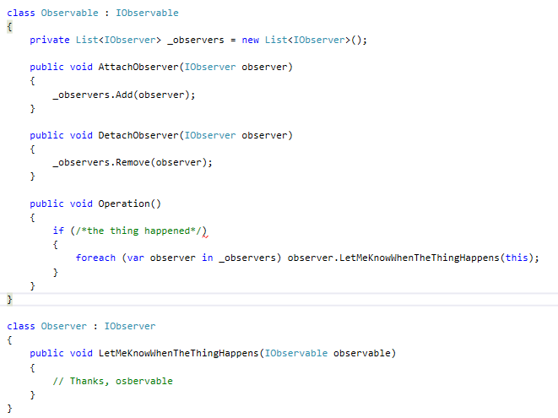
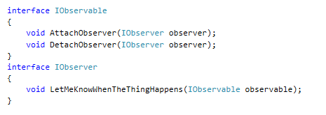
Observer Design Pattern (interface based or event based)

Slide 26
Observer Design Pattern (interface based or event based)
Does not give you one unified data structure like RxDataStructure<T> that you can query over.
Not compositional.
Blocking
Can cause memory wastage if you forget to Detach.

Slide 27
With Rx you can do
// return RxDataStructure<Foo>
var rxOfFoos = GetRxOfFoos();
// now query it LINQ style using
// standard LINQ query operators
var query = from foo in rxOfFoos
where foo.Bar > foo.Gar
select new { Bar = foo.Bar, Gar = foo.Gar };

Slide 28
Push based data model
Data source
Your program

Slide 29
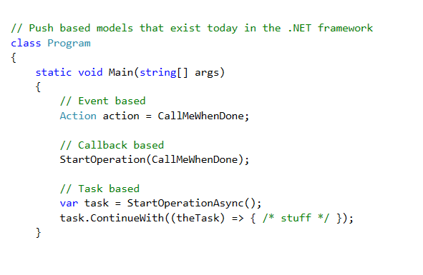
Push based data models

Slide 30
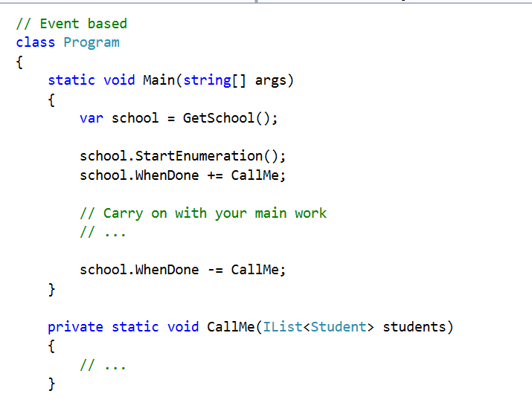
Push based data model (EAP)

Slide 31
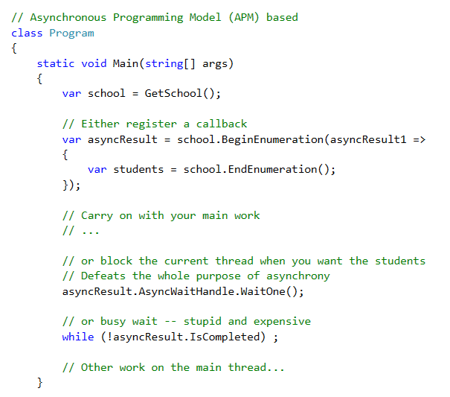
Push based data model (APM)

Slide 32
What you can’t do with traditional push-based data models available today
public void SomeMethod(event WhenDone)
{
}
public event WhenDone GetWhenDoneEvent()
{
}
// Events are not first class citizens

Slide 33
What you can’t do with traditional push-based data models available today
You cannot compose events
For e.g. when a student joins any of these five schools, let me know.

Slide 34
What you can’t do with traditional push-based data models available today
You cannot reason about events with respect to time
For e.g: If two students join this school within 2 hours of each other, let me know.

Slide 35
What you can’t do with traditional push-based data models available today
You cannot build complex queries over events from disparate data sources
For e.g. for the next student that joins any of these three schools, if the students join them within the same week and if their addresses happen to be the same, then do something about it. May be inform the Facebook graph API that they might know each other so it can show them in each other’s People You May Know section.

Slide 36
What you can’t do with traditional push-based data models available today
You will find it very difficult to create a composite event source from disparate data sources but have the event notifications be handled by a common event handler.
Or to have the common event handler be further queried and passed around to another function to have more queries attached to it.
What if you wanted to schedule the notifications, i.e. the call to the common event handler on different synchronization contexts under different conditions?

Slide 37
Rx makes all of this a walk in the park
The Reactive Extensions (Rx) is a library
for composing asynchronous and event-based programs
using observable sequences
and LINQ-style query operators.

Slide 38
Rx makes all of this a walk in the park
Using Rx, parameterize the concurrency in the asynchronous data streams using Schedulers.
Simply put, Rx = Observables + LINQ + Schedulers.

Slide 39
Rx
Event A
Event Source A
Pipeline
Query using LINQ syntax
Event B
Event Source B

Slide 40
Where to get Rx from?
Download the MSI Installer from
Install-Package Rx-Main
Search NuGet for “Rx-Main”

Slide 41
Current Stable Version
v2.2.5

Slide 42
Rx makes composing events a piece of cake

Slide 43
Querying events with Rx

Slide 44
Waiting for an async operation to complete using Rx

Slide 45
Passing events around as parameters or return values

Slide 46
Retrying an asynchronous operation several times until success and defining a failure action

Slide 47
Deriving IObservable<T> and IObserver<T>: the duals of IEnumerable<T> and IEnumerator<T> respectively

Slide 48
Four Steps to Using an IObservable<T>
Create the IObservable<T> query
Subscribe to the observable
Get a value or exception or completion signal from the observable
Dispose off the subscription

Slide 49
The Four Steps to Using an IObservable<T>: Creating an IObserver<T> implementation by hand

Slide 50
The Four Steps to Using an IObservable<T>: passing in lambdas for the value, error and completion handlers

Slide 51
Converting an IEnumerable<T> into an IObservable<T>

Slide 52
Marble Diagrams
(y)
Operator
f()
Value / Event
Time
(x)

Slide 53
Marble Diagrams
(y)
Operator
f()
Completion
Time
(x)

Slide 54
Marble Diagrams
(y)
Operator
f()
Error
Time
(x)

Slide 55
Marble Diagrams
Time
Completion
Input sequence
f()
f()
f()
f()
Operator
Output sequence

Slide 56
Marble Diagrams
Completion
Input sequence
f()
f()
Operator
Output sequence
Time

Slide 57
Marble Diagrams
Error
Input sequence
f()
f()
Operator
Output sequence
Time

Slide 58
IObservable<T> Contract
OnNext * (OnCompleted | OnError)
Synchronized notification

Slide 59
Impossible according to IObservable<T> Contract

Slide 60
Impossible according to IObservable<T> Contract

Slide 61
Impossible according to IObservable<T> Contract

Slide 62
Ways to create observables and observers
You do not need to create a class that implements IObservable<T>.
You use the query operators available on IObservable<T> to create an observable.
You can create a class that implements IObserver<T>
Or you can call the Create method on the Observer class passing in the lambdas to get an instance of an implementation of IObserver<T>.
Or you simply pass the onNext, onError and onCompletion lambdas to the Subscribe method on the IObservable<T> instance you get from a query operator and it creates an AnonymousObserver for you.

Slide 63
Default onNext, onError and onCompletion handlers
onNext default: (T value) => { }
onError default: (Exception ex) => throw ex;
onCompletion default: () => { }

Slide 64
Ways to Create Observables and Observers

Slide 65
Schedulers and Concurrency
Available schedulers are:
1. CurrentThreadScheduler
2. ThreadPoolScheduler
3. TaskPoolScheduler
4. DefaultScheduler
5. ImmediateScheduler
6. EventLoopScheduler
7. DispatcherScheduler (WPF)
8. ControlScheduler (WinForms)

Slide 66
Schedulers and Concurrency
Choosing a scheduler for the observable query
Subscribing on a specified scheduler
Observing on a specified scheduler

Slide 67
Using Schedulers

Slide 68
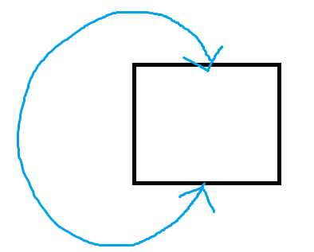
What is a monad?
A data structure
Represents computations defined as a series of steps
The computations are chainable in that:
The input of each computation is the monad itself, with other input.
The output of the computation is also the monad.

Slide 69
What is a monad?
IEnumerable<T>
IObservable<T>

Slide 70
Combinators / Operators on IObservable<T>
37 operators that used to also be on the IEnumerable<T> are now on IObservable<T> as well. You’ll already be familiar with these.
public static IObservable<TSource> Aggregate<TSource>(this IObservable<TSource> source, Func<TSource, TSource, TSource> accumulator);
public static IObservable<bool> All<TSource>(this IObservable<TSource> source, Func<TSource, bool> predicate);
public static IObservable<bool> Any<TSource>(this IObservable<TSource> source, Func<TSource, bool> predicate);
public static IObservable<double?> Average<TSource>(this IObservable<TSource> source, Func<TSource, int?> selector);
...

Slide 71
Combinators / Operators on IObservable<T>
6 of the operators that used to also be on the IEnumerable<T> are now on IObservable<T> as well but they are implemented greedily so they are recommended against.
[Obsolete]
public static TSource First<TSource>(this IObservable<TSource> source);
public static TSource FirstOrDefault<TSource>(this IObservable<TSource> source, Func<TSource, bool> predicate);
public static TSource Last<TSource>(this IObservable<TSource> source);
public static TSource LastOrDefault<TSource>(this IObservable<TSource> source);
public static TSource Single<TSource>(this IObservable<TSource> source);
public static TSource SingleOrDefault<TSource>(this IObservable<TSource> source);

Slide 72
Combinators / Operators on IObservable<T>
2 of the operators on IObservable<T> are for converting an observable to an enumerable.
// 2 house-keeping or administrative methods
public static IEnumerator<TSource> GetEnumerator<TSource>(this IObservable<TSource> source);
public static IEnumerable<TSource> ToEnumerable<TSource>(this IObservable<TSource> source);

Slide 73
Combinators / Operators on IObservable<T>
The rest of 83 odd operators are new in IObservable<T> that were not in IEnumerable<T>
// 83 new ones
Buffer
Scan
. . .

Slide 74
Interactive Extensions (Ix.NET)
Some of these 83 odd new operators of IObservable<T> have been backported to Ienumerable<T> as well as a part of another project named Interactive Extensions, or Ix.NET for short.
// IEnumerable<T>’s got new ones
public static class EnumerableEx
{
IEnumerable<T> Share(this IEnumerable<T>, …);
IEnumerable<T> Publish(this IEnumerable<T>, …);
. . .
}

Slide 75
A few simple operators
ToObservable: Converts an IEnumerable<T> to an IObservable<T>.
Range: Generates an observable sequence of integral numbers within a specified range.
Return: Returns an observable sequence that contains a single element.
Concat: Serially concatenates two or more observable sequences into a single observable, as long as the previous observable sequence terminated successfully.
Do: Can be used to inject side effects into an observable.
StartWith: Prepends a sequence of values to an observable sequence.
Never: Returns a non-terminating observable sequence, which can be used to denote an infinite duration. This will never produce a value nor a completion message and neither an error.

Slide 76

A few simple operators
ToObservable: Converts an IEnumerable<T> to an IObservable<T>.
public static IObservable<TSource> ToObservable<TSource>(
this IEnumerable<TSource> source);
public static IObservable<TSource> ToObservable<TSource>(
this IEnumerable<TSource> source,
IScheduler scheduler);

Slide 77
A few simple operators
Range: Generates an observable sequence of integral numbers within a specified range.
public static IObservable<int> Range(int start, int count);
public static IObservable<int> Range(int start, int count, IScheduler scheduler);

Slide 78
A few simple operators
Return: Returns an observable sequence that contains a single element.
public static IObservable<TResult> Return<TResult>(TResult value);
public static IObservable<TResult> Return<TResult>(TResult value, IScheduler scheduler);

Slide 79
A few simple operators
Concat: Serially concatenates two or more observable sequences into a single observable, as long as the previous observable sequence terminated successfully.
public static IObservable<TSource> Concat<TSource>(this IEnumerable<IObservable<TSource>> sources);
public static IObservable<TSource> Concat<TSource>(this IObservable<IObservable<TSource>> sources);
public static IObservable<TSource> Concat<TSource>(this IObservable<Task<TSource>> sources);
public static IObservable<TSource> Concat<TSource>(params IObservable<TSource>[] sources);
public static IObservable<TSource> Concat<TSource>(this IObservable<TSource> first, IObservable<TSource> second);

Slide 80
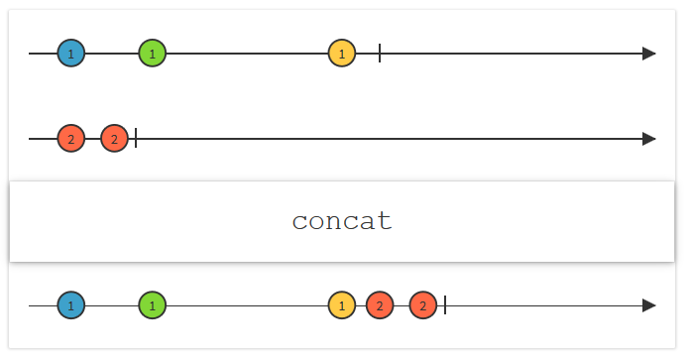
Marble Diagram: Concat
Concat: Serially concatenates two or more observable sequences into a single observable, as long as the previous observable sequence terminated successfully.
Image source: http://reactivex.io/

Slide 81
A few simple operators
Do: Can be used to inject side effects into an observable.
public static IObservable<TSource> Do<TSource>(this IObservable<TSource> source, Action<TSource> onNext);
public static IObservable<TSource> Do<TSource>(this IObservable<TSource> source, IObserver<TSource> observer);
public static IObservable<TSource> Do<TSource>(this IObservable<TSource> source, Action<TSource> onNext, Action onCompleted);
public static IObservable<TSource> Do<TSource>(this IObservable<TSource> source, Action<TSource> onNext, Action<Exception> onError);
public static IObservable<TSource> Do<TSource>(this IObservable<TSource> source, Action<TSource> onNext, Action<Exception> onError, Action onCompleted);

Slide 82
A few simple operators
StartWith: Prepends a sequence of values to an observable sequence.
public static IObservable<TSource> StartWith<TSource>(this IObservable<TSource> source, IEnumerable<TSource> values);
public static IObservable<TSource> StartWith<TSource>(this IObservable<TSource> source, params TSource[] values);
public static IObservable<TSource> StartWith<TSource>(this IObservable<TSource> source, IScheduler scheduler, params TSource[] values);
public static IObservable<TSource> StartWith<TSource>(this IObservable<TSource> source, IScheduler scheduler, IEnumerable<TSource> values);

Slide 83
A few simple operators
Never: Returns a non-terminating observable sequence, which can be used to denote an infinite duration. This will never produce a value nor a completion message and neither an error.
public static IObservable<TResult> Never<TResult>();
public static IObservable<TResult> Never<TResult>(TResult witness);

Slide 84
Using the simple operators we just learnt about

Slide 85
A few more operators
TakeUntil: Returns the elements from the source observable sequence until the other observable sequence produces an element. Another overload takes elements for the specified duration until the specified end time.
TakeWhile: Returns elements from an observable sequence as long as a specified condition is true.
Aggregate: Same as the behavior of aggregate on enumerable, except that it works on and returns an observable.
Scan: Applies an accumulator function over an observable sequence and returns each intermediate result.
Throw: Returns an observable sequence that terminates with an exception.
Retry: Repeats the source observable sequence the specified number of times or until it successfully terminates.
Catch: Continues an observable sequence that is terminated by an exception with the next observable sequence.

Slide 86
TakeUntil
TakeUntil: Returns the elements from the source observable sequence until the other observable sequence produces an element. Another overload takes elements for the specified duration until the specified end time.
public static IObservable<TSource> TakeUntil<TSource, TOther>(this IObservable<TSource> source, IObservable<TOther> other);
public static IObservable<TSource> TakeUntil<TSource>(this IObservable<TSource> source, DateTimeOffset endTime);
public static IObservable<TSource> TakeUntil<TSource>(this IObservable<TSource> source, DateTimeOffset endTime, IScheduler scheduler);

Slide 87
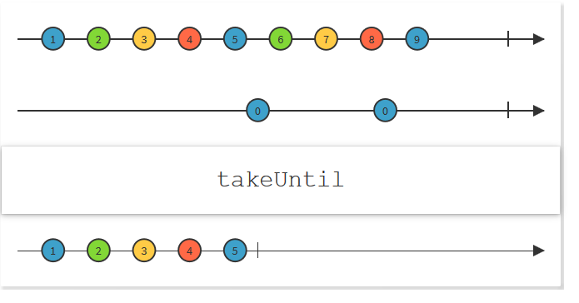
Marble Diagram: TakeUntil
TakeUntil: Returns the elements from the source observable sequence until the other observable sequence produces an element. Another overload takes elements for the specified duration until the specified end time.
Image source: http://reactivex.io/

Slide 88
TakeWhile
TakeWhile: Returns elements from an observable sequence as long as a specified condition is true.
public static IObservable<TSource> TakeWhile<TSource>(this IObservable<TSource> source, Func<TSource, bool> predicate);
public static IObservable<TSource> TakeWhile<TSource>(this IObservable<TSource> source, Func<TSource, int, bool> predicate);

Slide 89
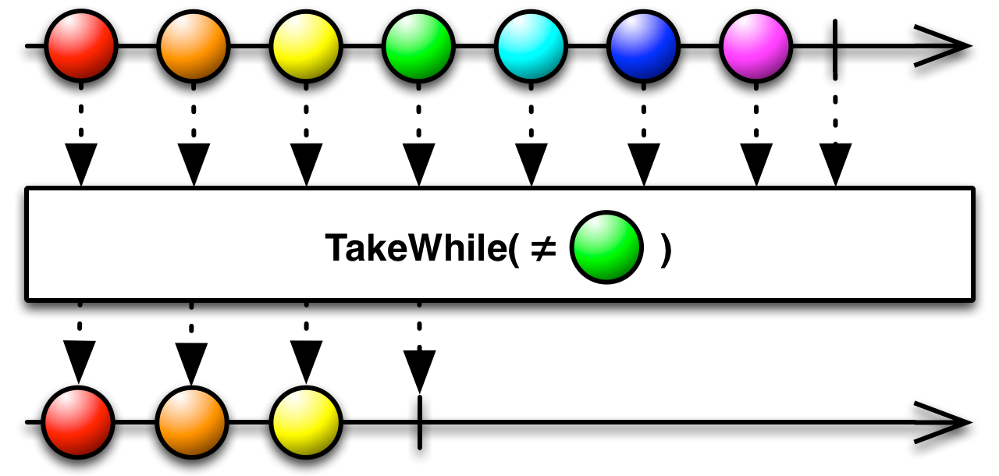
Marble Diagram: TakeWhile
TakeWhile: Returns elements from an observable sequence as long as a specified condition is true.
Image source: http://reactivex.io/

Slide 90
Scan
Scan: Applies an accumulator function over an observable sequence and returns each intermediate result.
public static IObservable<TSource> Scan<TSource>(this IObservable<TSource> source,
Func<TSource, TSource, TSource> accumulator);
public static IObservable<TAccumulate> Scan<TSource, TAccumulate>(
this IObservable<TSource> source,
TAccumulate seed,
Func<TAccumulate, TSource, TAccumulate> accumulator);

Slide 91
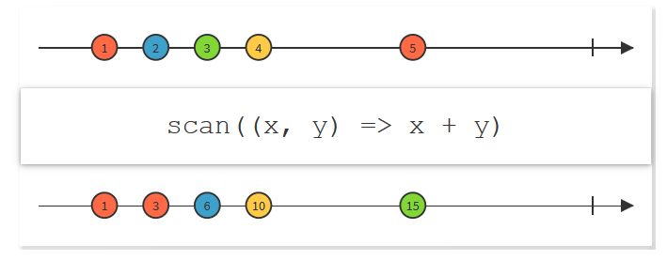
Marble Diagram: Scan
Scan: Applies an accumulator function over an observable sequence and returns each intermediate result.
Image source: http://reactivex.io/

Slide 92
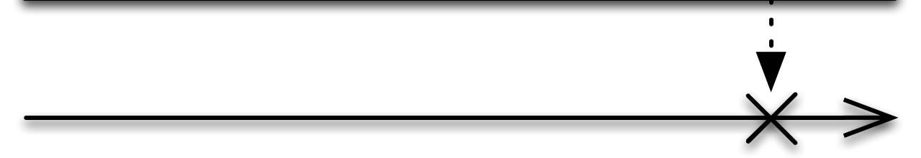
Marble Diagram: Throw
Throw: Returns an observable sequence that terminates with an exception.
Image source: http://reactivex.io/

Slide 93
Throw
Throw: Returns an observable sequence that terminates with an exception.
public static IObservable<TResult> Throw<TResult>(Exception exception);
public static IObservable<TResult> Throw<TResult>(Exception exception, IScheduler scheduler);
public static IObservable<TResult> Throw<TResult>(Exception exception, TResult witness);
public static IObservable<TResult> Throw<TResult>(Exception exception, IScheduler scheduler, TResult witness);

Slide 94
Retry
Retry: Repeats the source observable sequence the specified number of times or until it successfully terminates.
public static IObservable<TSource> Retry<TSource>(this IObservable<TSource> source);
public static IObservable<TSource> Retry<TSource>(this IObservable<TSource> source, int retryCount);

Slide 95
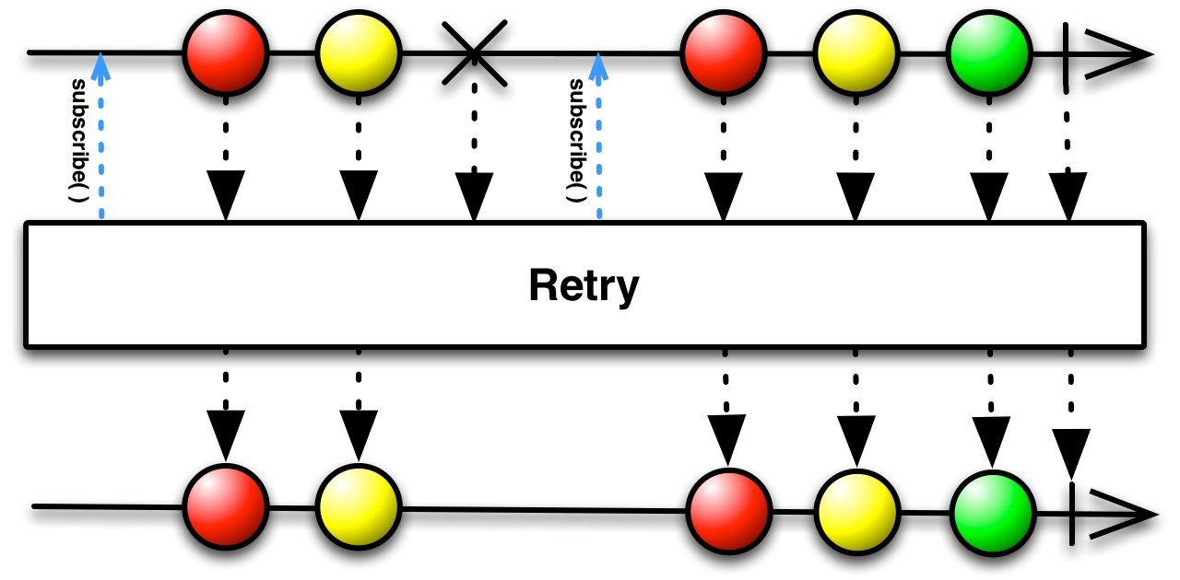
Marble Diagram: Retry
Retry: Repeats the source observable sequence the specified number of times or until it successfully terminates.
Image source: http://reactivex.io/

Slide 96
Catch
Catch: Continues an observable sequence that is terminated by an exception with the next observable sequence.
public static IObservable<TSource> Catch<TSource>(this IEnumerable<IObservable<TSource>> sources);
public static IObservable<TSource> Catch<TSource>(params IObservable<TSource>[] sources);
public static IObservable<TSource> Catch<TSource, TException>(this IObservable<TSource> source, Func<TException, IObservable<TSource>> handler) where TException: Exception;
public static IObservable<TSource> Catch<TSource>(this IObservable<TSource> first, IObservable<TSource> second);

Slide 97
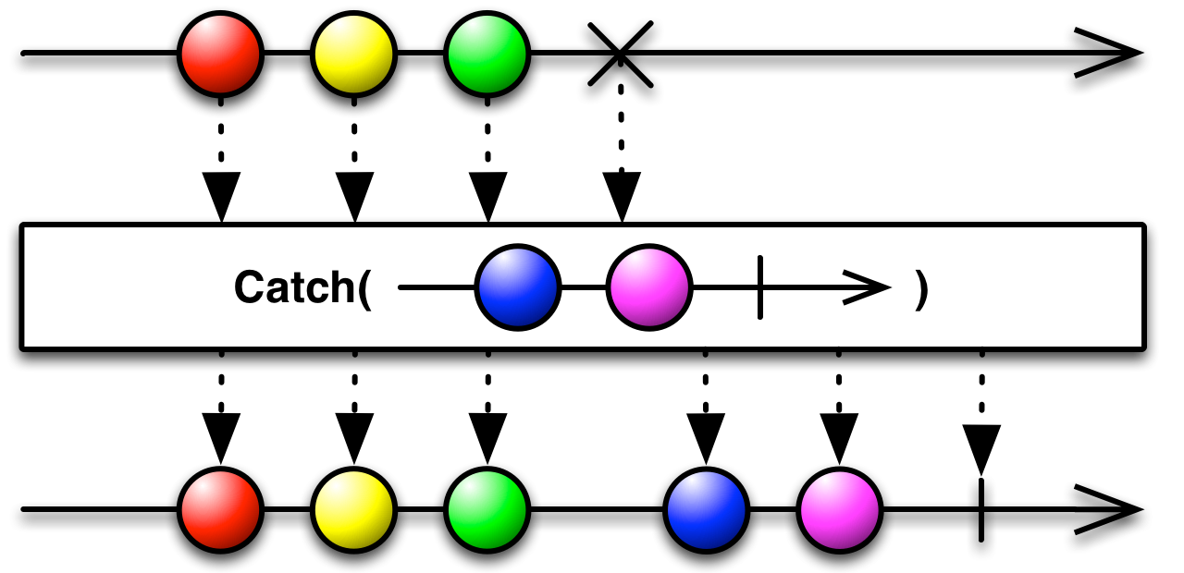
Marble Diagram: Catch
Catch: Continues an observable sequence that is terminated by an exception with the next observable sequence.
Image source: http://reactivex.io/

Slide 98
Using TakeWhile, TakeUntil, Aggregate, Scan, Catch and Retry

Slide 99
A Brief Look at Some More Conditional Selection Operators
public static IObservable<TSource> TakeLast<TSource>(this IObservable<TSource> source, int count);
public static IObservable<TSource> SingleAsync<TSource>(this IObservable<TSource> source);
public static IObservable<TSource> SingleOrDefaultAsync<TSource>(this IObservable<TSource> source, Func<TSource, bool> predicate);
public static IObservable<TSource> SkipLast<TSource>(this IObservable<TSource> source, TimeSpan duration, IScheduler scheduler);
public static IObservable<TSource> TakeUntil<TSource, TOther>(this IObservable<TSource> source, IObservable<TOther> other);

Slide 100
A Brief Look at Some More Conditional Selection Operators (contd…)
IObservable<IList<T>> TakeLast(int count | TimeSpan duration);
public static IObservable<TSource> FirstAsync<TSource>(this IObservable<TSource> source, Func<TSource, bool> predicate);
public static IObservable<TSource> FirstOrDefaultAsync<TSource>(this IObservable<TSource> source, Func<TSource, bool> predicate);
public static IObservable<TSource> LastAsync<TSource>(this IObservable<TSource> source, Func<TSource, bool> predicate);
public static IObservable<TSource> LastOrDefaultAsync<TSource>(this IObservable<TSource> source, Func<TSource, bool> predicate);
public static TSource Wait<TSource>(this IObservable<TSource> source);

Slide 101
Using Conditional Selection Operators

Slide 102
Transformational / Projection Operators
CombineLatest: Merges the specified observable sequences into one observable sequence by emitting a list with the latest source elements whenever any of the observable sequences produces an element.
Zip: Same as enumerable's. Merges the specified observable sequences into one observable sequence by emitting a list with the elements of the observable sequences at corresponding indexes.
Merge: Merges elements from all observable sequences in the given enumerable sequence into a single observable sequence.
SelectMany: Same as enumerable's. Projects each element of an observable sequence to an enumerable sequence and concatenates the resulting enumerable sequences into one observable sequence.
Materialize: Materializes the implicit notifications of an observable sequence as explicit notification values. Basically converts an observable with values into an observable that has the values plus metadata those values.
Dematerialize: Dematerializes the explicit notification values of an observable sequence as implicit notifications. Basically, reverses the materialization. Goes back from an observable that had values and metadata and produces an observable that had just the original values.

Slide 103
Using Transformational Operators

Slide 104
Time based operators
Timer: Returns an observable sequence that periodically produces a value starting at the specified initial absolute due time.
Timestamp: Timestamp each element in an observable sequence using the clock of the specified scheduler.
TimeInterval: Records the time interval between consecutive elements in an observable sequence.
Timeout: Applies a timeout policy to the observable sequence based on an absolute time. If the sequence doesn't terminate before the specified absolute due time, a TimeoutException is propagated to the observer.
Interval: Returns an observable sequence that produces a value after each period.
Buffer: Projects each element of an observable sequence into consecutive non-overlapping buffers which are produced based on timing information or on the count of items per buffer.
Window: Same as Buffer but returns an IObservable<IObservable<T>> instead of IObservable<IList<T>>.

Slide 105
More Time based operators
Throttle: Ignores elements from an observable sequence which are followed by another element within a specified relative time duration.
Delay: Time shifts the observable sequence to start propagating notifications at the specified absolute time. The relative time intervals between the values are preserved.
Sample: Samples the source observable sequence using a samper observable sequence producing sampling ticks. Upon each sampling tick, the latest element (if any) in the source sequence during the last sampling interval is sent to the resulting sequence.
TaskLastBuffer: Returns a list with the elements within the specified duration from the end of the observable source sequence.
Amb (race): Propagates the observable sequence that reacts first.

Slide 106
DistinctUntilChanged
Returns an observable sequence that contains only distinct contiguous elements according to the comparer.

Slide 107
Using Time based Operators and DistinctUntilChanged

Slide 108
Hot vs. Cold Observables
A hot observable produces values whether or not you subscribe to it. E.g. mouse moves, mouse clicks, stock tickers.
Values of a hot observable are shared between its subscribers. E.g. all subscribers to a stock ticker will get the same price updates.
A cold observable is stale.
Cold observables start running upon subscription, i.e., the observable sequence only starts pushing values to the observers when Subscribe is called.
Values of a cold observable are also not shared among subscribers.

Slide 109
* Using a hot observable * Converting a cold observable into a hot one * The Publish operator * The IConnectableObservable<T>

Slide 110
Taking a peek inside Rx to see how it works.

Slide 111
Further Reading
Lee Campbell’s free book available online: http://www.introtorx.com/content/v1.0.10621.0/00_Foreword.html
Rx Vidoes on Channel 9: https://channel9.msdn.com/Tags/rx
Rx Workshop Videos on Channel 9: https://channel9.msdn.com/Series/Rx-Workshop
Documentation on Github: https://github.com/Reactive-Extensions/RxJS/tree/master/doc or the same documentation is available on MSDN at https://msdn.microsoft.com/en-us/library/hh242985(v=vs.103).aspx

Slide 113
Thank you
I can be reached at:
Sathyaish@gmail.com
LinkedIn: https://in.linkedin.com/in/Sathyaish

